Slide 1
Crucible
Act 1 Scene 1
Vocabulary

Slide 2
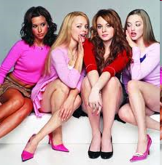
Faction
A group or a clique

Slide 3
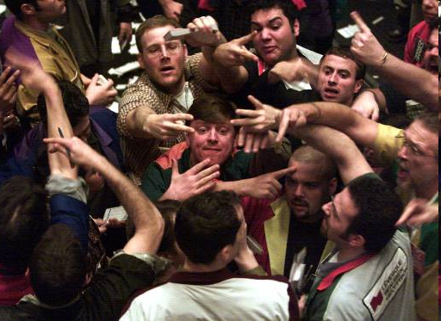
Trafficked
Traded, had dealing or associations

Slide 4
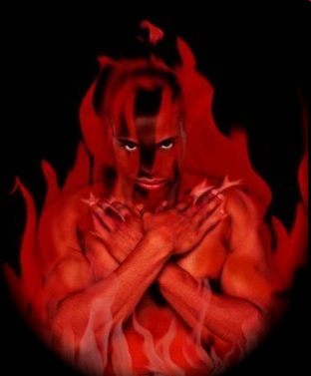
Heathen
An uncivilized or irreligious person

Slide 5
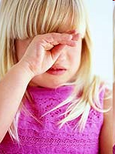
Sniveling
Speaking or acting in a whining, sniffling, tearful or weakly manner

Slide 6
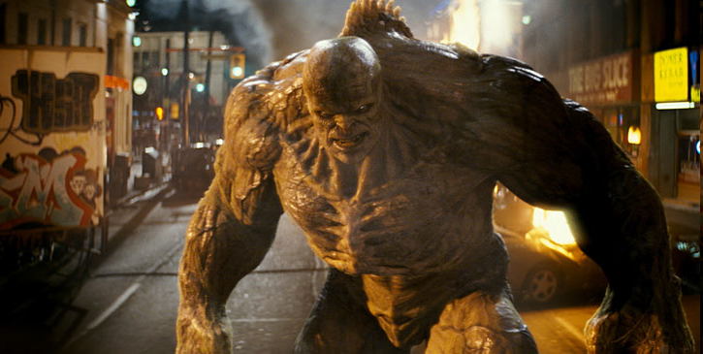
Abomination
Sources of utter disgust or intense dislike; hateful disgusting actions

