Slide 1
Act 2 Vocab

Slide 2
Ameliorate
To improve or make better

Slide 3
Condemnation
The act of completely disapproving of something

Slide 4
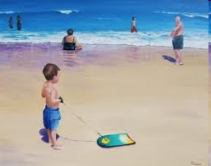
Falter
To lose courage or confidence

Slide 5
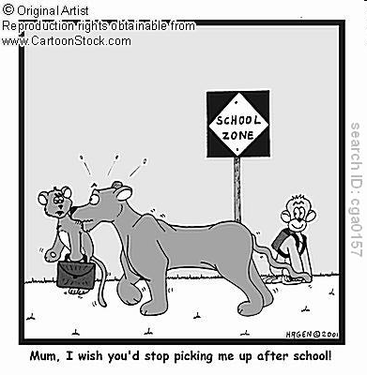
Dote
To show excessive love or fondness

Slide 6
Scoffing
To mock or ridicule someone

Slide 7
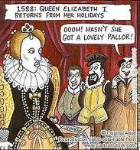
Pallor
A pale condition that looks unnatural

Slide 8
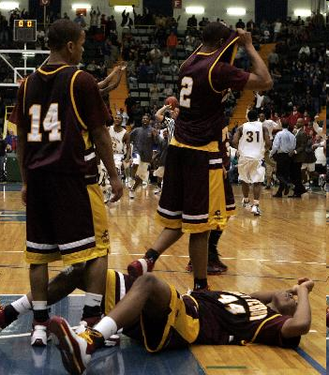
Conceding
To admit to something, usually reluctantly

Slide 9
deference
respect

Slide 10
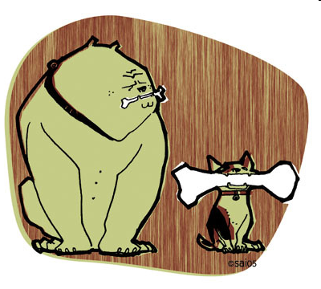
begrudge
To envy the possession of something

