Slide 1
Act 3 Vocab

Slide 2
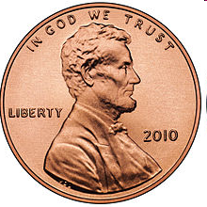
trifle
Of little importance

Slide 3

tainted
a trace of bad in something

Slide 4
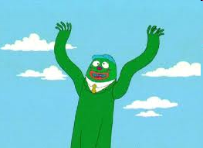
flailing
Moving arms around violently

Slide 5
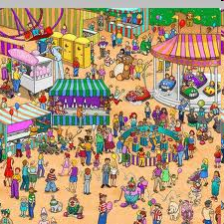
subtle
Not obvious

Slide 6
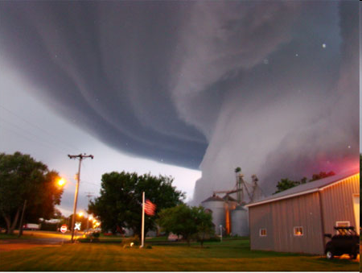
calamity
A great misfortune

Slide 7
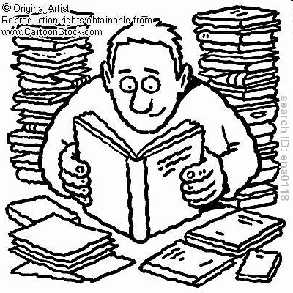
avid
enthusiastic

Slide 8
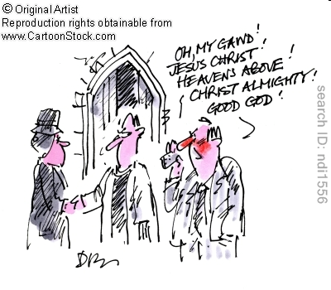
blasphemy
Disrespectful words or actions about a religion

Slide 9
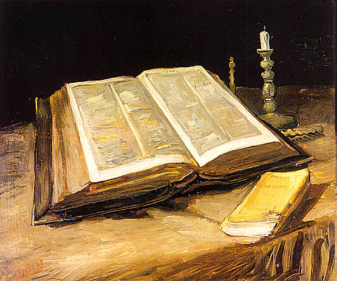
theology
Study of religion

Slide 10
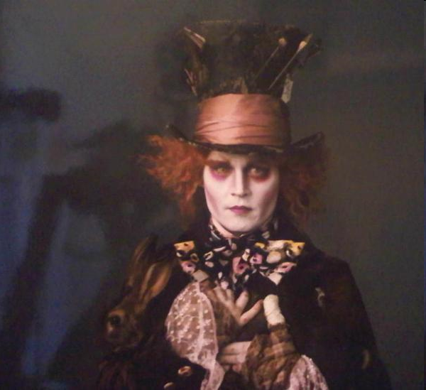
daft
Crazy, mad, stupid

Slide 11
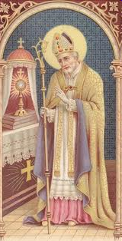
pious
Devoted to and respectful of religion

Slide 12
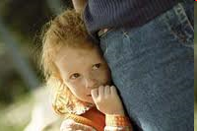
evasive
Trying to avoid or escape

Slide 13
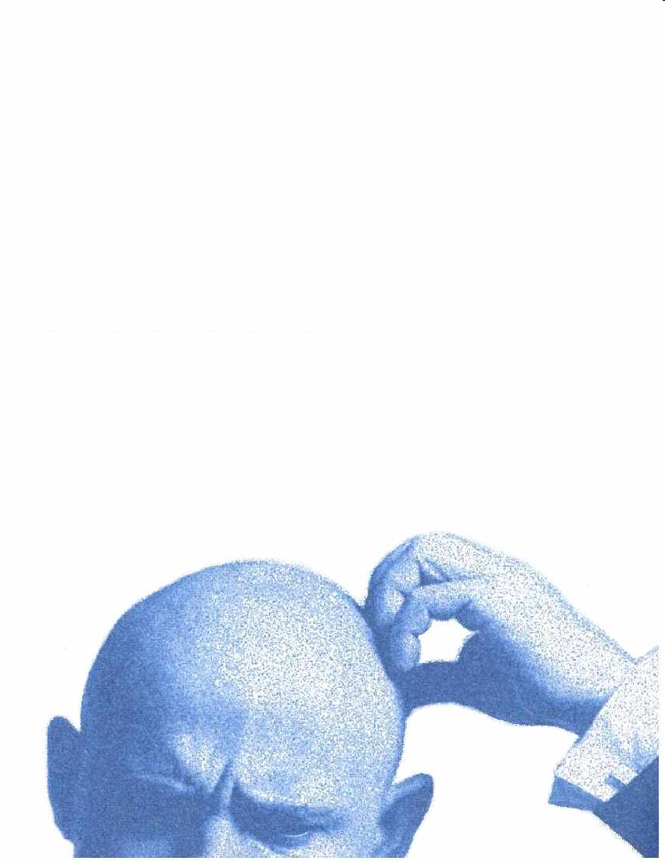
misgivings
Feelings of doubt

Slide 14

vengeance
Violent revenge

