Slide 1
Act 4 Vocab

Slide 2
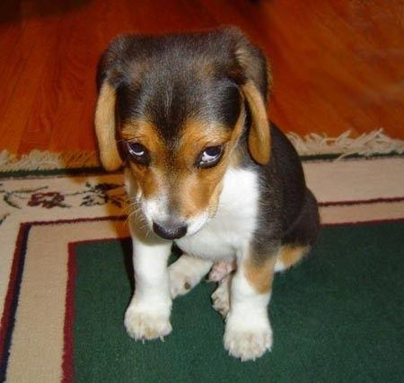
Conciliatory
Winning over someone, reconcile differences

Slide 3
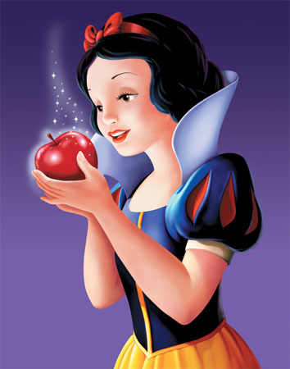
Beguile
Using trickery or flattery to deceive someone

Slide 4
Floundering
To struggle helplessly

Slide 5
Adamant
Not willing to give up your opinion regardless of other arguments

Slide 6
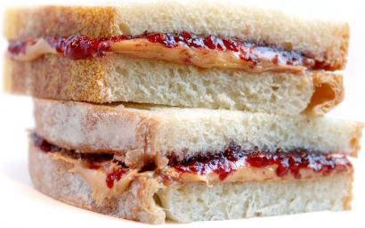
Cleave
To stick together closely

Slide 7
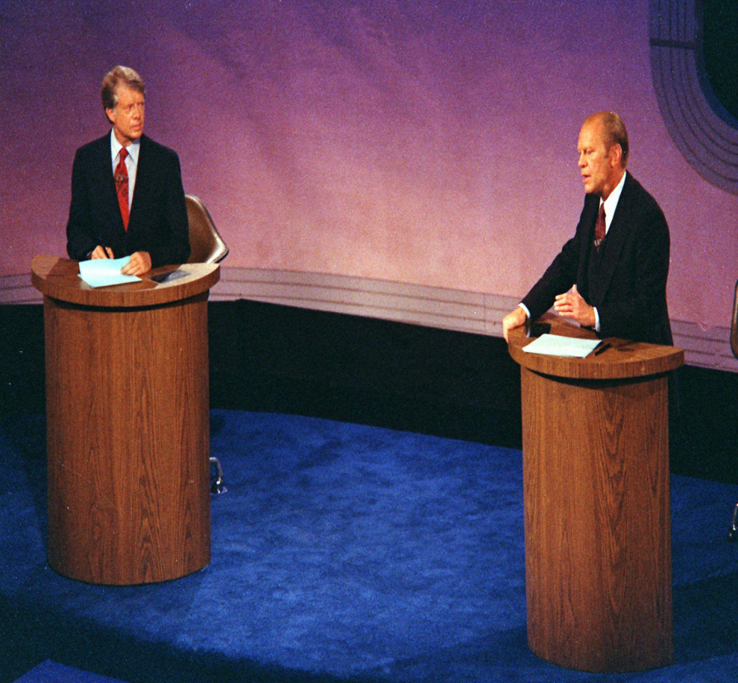
Disputation
To argue or debate

