Slide 1
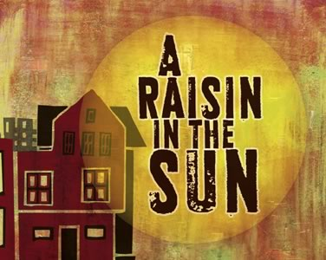
By Lorraine Hansberry

Slide 2
Lorraine Hansberry author
1930-1965
Writer, journalist, and activist
Her family faced racial segregation when they lived in Chicago

Slide 3
A Raisin in the Sun Her most important work
All photo-stills from 1961 Daniel Petrie production
Setting:
Sometime between 1940s and 1959, South-side Chicago
Main Characters:
Walter Younger
Ruth Younger
Lena “Mama” Younger
Beneatha Younger
Travis Younger

Slide 4
Ruth
A mother, wife, and maid in Chicago
Loves and cares for her family, but struggles
Conflicts: caring for her husband and child

Slide 5
Walter
Ruth’s husband
Tries to provide for his family, but struggles
Conflicts: Money, Learning how to be a man

Slide 6
Mama
Walter and Beneatha’s mother
Recently lost her husband
Conflicts: Raising her children

Slide 7
Beneatha
Walter’s sister
Studying at college to become a doctor
Conflicts: Struggles to express herself, is confused about how to find her way
en.wikipedia.org/wiki/Diana_Sands

Slide 8
Travis
Ruth and Walter’s Son
Sleeps on the couch, attends school
Seems to be a symbolic character…

Slide 9
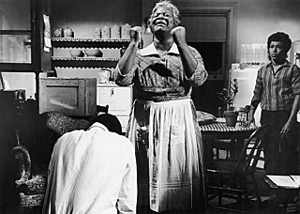
Conflicts
The family disagrees
Characters let their family down
Segregation and racism

Slide 10
Symbols
See if you can analyze the following images, and interpret a deeper meaning out of them…
Money
Plants
Children

