Slide 1
Background on Of Mice and Men and author, John Steinbeck
Work alone or in pairs
Due at end of hour
You will be called on tomorrow to answer questions about what you read.
Use your time in class wisely!
Directions
Read each slide
If it is informational and has no questions, write the 1-2 most important points of that slide on the lines to the right, in your own words.
If it is a picture, describe what you see on the lines to the right.
If there is a question on the slide, answer it on the lines to the right
POINTS
25 for completing packet
Up to 25 points for answering questions in discussion tomorrow

Slide 2
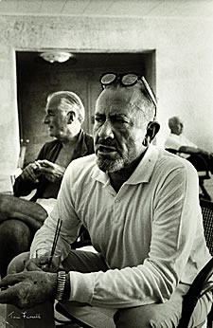
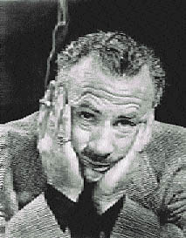
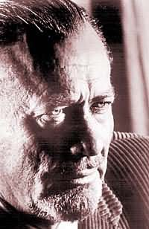
John Steinbeck One of The Great American Writers of the 20th Century

Slide 3
A Look at the Author
Born February 27th in 1902 in Salinas, California,
John was the 3rd of 4 children, and the only son.
During his childhood, Steinbeck
learned to appreciate his surroundings,
and loved the Salinas countryside and
the nearby Pacific Ocean; it would be
this appreciation that would later come
out in his writing
Steinbeck worked during his summers as a hired
hand in nearby ranches

Slide 4
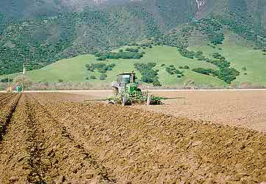
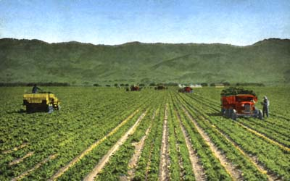
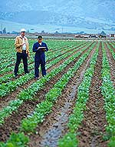
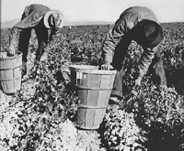
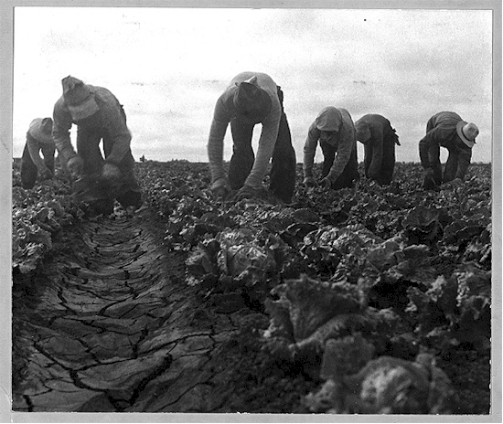
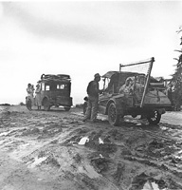
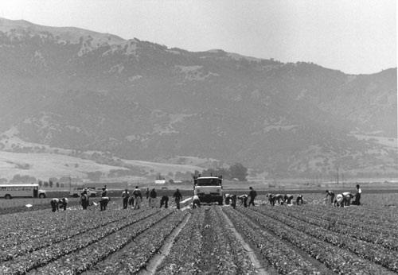
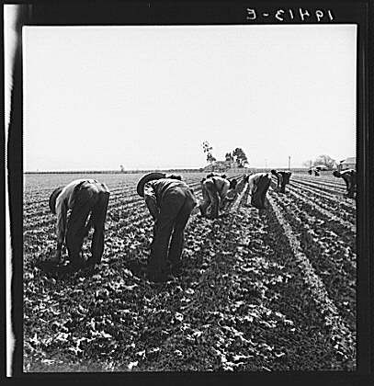
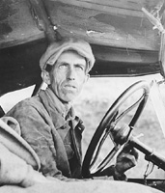
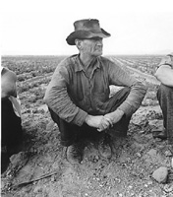
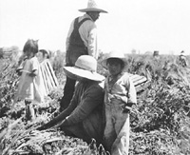
The Fields of Salinas, California

Slide 5
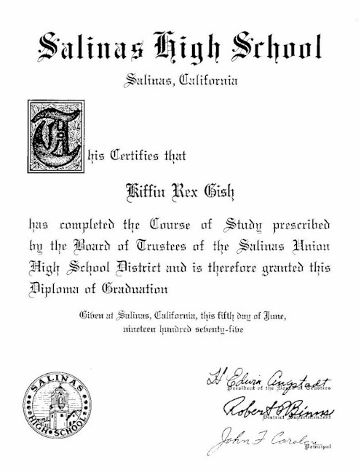
At the age of 14 he decided to be a writer
and spent a lot of time writing in his room
In high school, Steinbeck did well in English
and edited the school yearbook
1919-1925 Steinbeck attended Stanford Uni-
versity to please his parents, but only chose
courses that interested him, classical and British
Literature, writing courses and the odd science
course.
However, Steinbeck did not receive a degree
because he would drop in and out of school,
sometimes to work with migrant and bindlestiffs on
California ranches

Slide 6
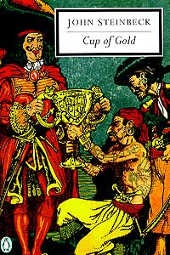
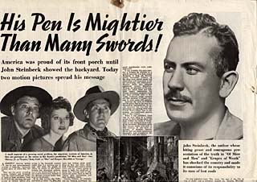
During the late 1920s and 1930s he concentrated on writing and wrote several novels set in California.
Steinbeck gained
great success by
readers and critics.

Slide 7
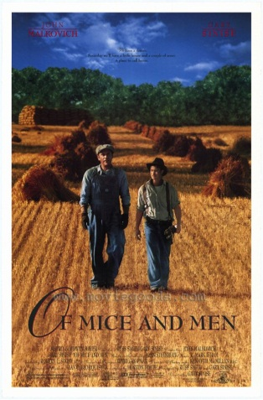
In 1929, he published his first novel, Cup of Gold
In 1930, Steinbeck married Carol Henning, and they
moved into his family’s home. His father helped support
the struggling couple, but unfortunately, they divorced in
1942.
In 1935, he won his first literary prize,
Commonwealth Club of California
Gold Medal for Best Novel by a
Californian for his novel, Tortilla Flat.
In 1936, Of Mice and Men was published,
and was so widely accepted that Steinbeck
began a book tour that led him to Europe.

Slide 8
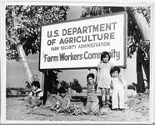
In 1939, The Grapes of Wrath
was published and became an
instant best-seller; in 1940 it was
awarded the Pulitzer Prize, one
of the most prestigious literary awards in the world.
This novel, just like Of Mice and Men,
stemmed from his experience working
among migrant workers.
Steinbeck’s experiences in the fields researching migrant
workers led him to have more compassion for these
workers, and stirred up his concern for social justice.

Slide 9
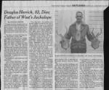
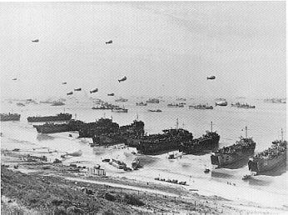
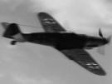
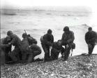
In 1943 he married Gwendolyn
Conger who would father him two
sons before their divorce in 1948.
In 1943 Steinbeck
worked as a war corre-
spondent for the New
York newspaper, Herald
Tribune.

Slide 10
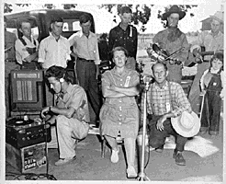
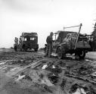
While living in Monterey, California Steinbeck said that he felt unwelcome as no one would rent him an office for writing, and he was harassed when trying to get fuel and wood from a local wartime rations board.
Steinbeck wrote that his old friends did not want him, partly because of his works and partly because he was so successful: “This isn't my country anymore. And it won't be until I am dead. It makes me very sad.” He left Monterey the next year and moved to New York.

Slide 11
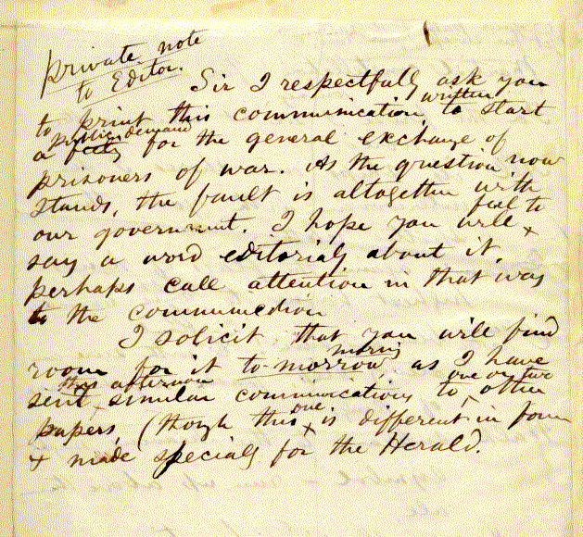
In 1948 he moved back to Monterey. A year later he met Elaine Scott, who in 1950 became his third wife.
Although he continued to write and publish, he never felt at ease in his life, and once wrote to an aspiring writer from Salinas:
“Don't think for a moment that you will ever be forgiven for being what they call ‘different.’ You won’t! I still have not been forgiven. Only when I am delivered in a pine box will I be considered ‘safe.’ After I had written the Grapes of Wrath the librarians at the Salinas Public Library, who had known my folks remarked that is was lucky my parents were dead so that they did not have to suffer this shame.”

Slide 12
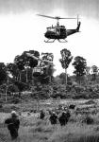
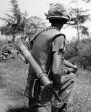
One of Steinbeck’s two sons fought in the Vietnam War, while Steinbeck himself was in Asia covering the war for Newsday, a Long Island newspaper.
Steinbeck lost a number of friends
during the anti-war movement due to
his open support of the war and
America’s involvement

Slide 13
Steinbeck’s last two books were nonfiction.
Travels with Charly in Search of America was an account of his trip from Maine to California with his poodle, Charly.
His final book, America and the Americans, was about his belief that in time, America would once again feel united.

Slide 14
John Steinbeck died on December 20, 1968 at his apartment in New York City.
His wife took him home to Salinas to be buried near the land that he spent his life writing about.

Slide 15
Now take a moment to review your worksheet and complete the “A look at the Author” section.

Slide 16
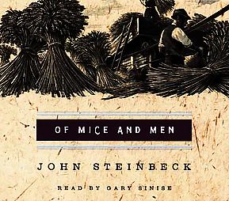
An Introduction

Slide 17
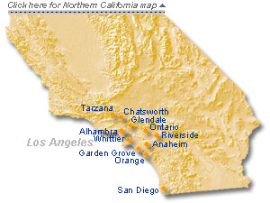
The setting of Mice and Men
The novel is set in the farmland of the Salinas valley, where John Steinbeck was born
The ranch in the novel is near Soledad, which is south-east of Salinas on the Salinas river.
The countryside described at the beginning of the novel, and the ranch itself is based on Steinbeck’s own experiences.

Slide 18
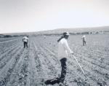
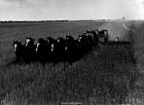
Historical Background to Migrant Workers
Before technology created farm machinery, humans had to do a lot of the farm work by hand.
Between the 1880s and the 1930s thousands of men would travel the countryside in search of work.
Such work included the harvesting of wheat.

Slide 19
Migrant workers cont’d
These workers would earn $2.50 or $3.00 a day, plus food and shelter.
During the 1930s, the unemployment rate was high in the U.S., and with so many men searching for work, agencies were set up to send farmworkers to where they were needed.
In the novel, George and Lennie (the two main characters) were given work cards from Murray and Ready’s, which was one of the farmwork agencies.

Slide 20
The American Dream
From the 17th Century onwards, immigrants have dreamed of a better life in America.
Many people immigrated to America in search of a new life for themselves or their families.
Many others immigrated to escape persecution or poverty in their homeland.

Slide 21
American Dream cont’d
These immigrants dreamed of making their fortunes in America.
For many this dream of riches became a nightmare.
→ there were horrors of slavery,
→ there were horrors of the American Civil War,
there was a growing number of slums that were just as bad as those in Europe,
there was also great corruption in the
American political system which led to many
shattered hopes

Slide 22
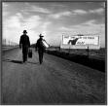
The idea of an American Dream for many was broken when in 1929, the Wall Street crashed, marking the beginning of the Great Depression.
This era affected the whole world during the 1930s, but even in the midst of hardship, some people’s dreams survived.
Thousands of people made their way west towards California to escape from their farmlands in the mid-West that were failing due to drought.
The characters of George and Lennie dreamt of having a “little house and a couple of acres” which was their own dream.

Slide 23
Of Mice and Men – title’s origin
The title of the novel comes from a poem by the Scottish poet Robert Burns (1759 -96)
The best laid schemes o’ mice and men
Gang aft agley [often go wrong]
And leave us nought but grief and pain
For promised joy!

Slide 24
John Steinbeck was an advocate of…
Equal rights
Civil rights
Women’s rights
Individual rights

Slide 25
Discussion...
So if Steinbeck was an advocate of these things why would he use derogatory terms toward women, racial slurs and slurs about individuals with mental handicaps in his writing?
Time & Place
Authenticity
Irony

Slide 26
As we read look for…
What the characters says about each other.
What the characters are called, but how their actions are opposite of these words.

Slide 27
Why do people use hateful words to describe others?
Insecurity
False sense of power
Cruelness

