Slide 1
To Kill a Mockingbird Vocabulary
Chapters 1 - 4

Slide 2
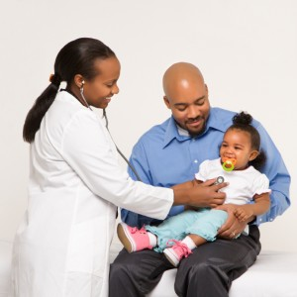
Assuaged
To ease or make better.

Slide 3
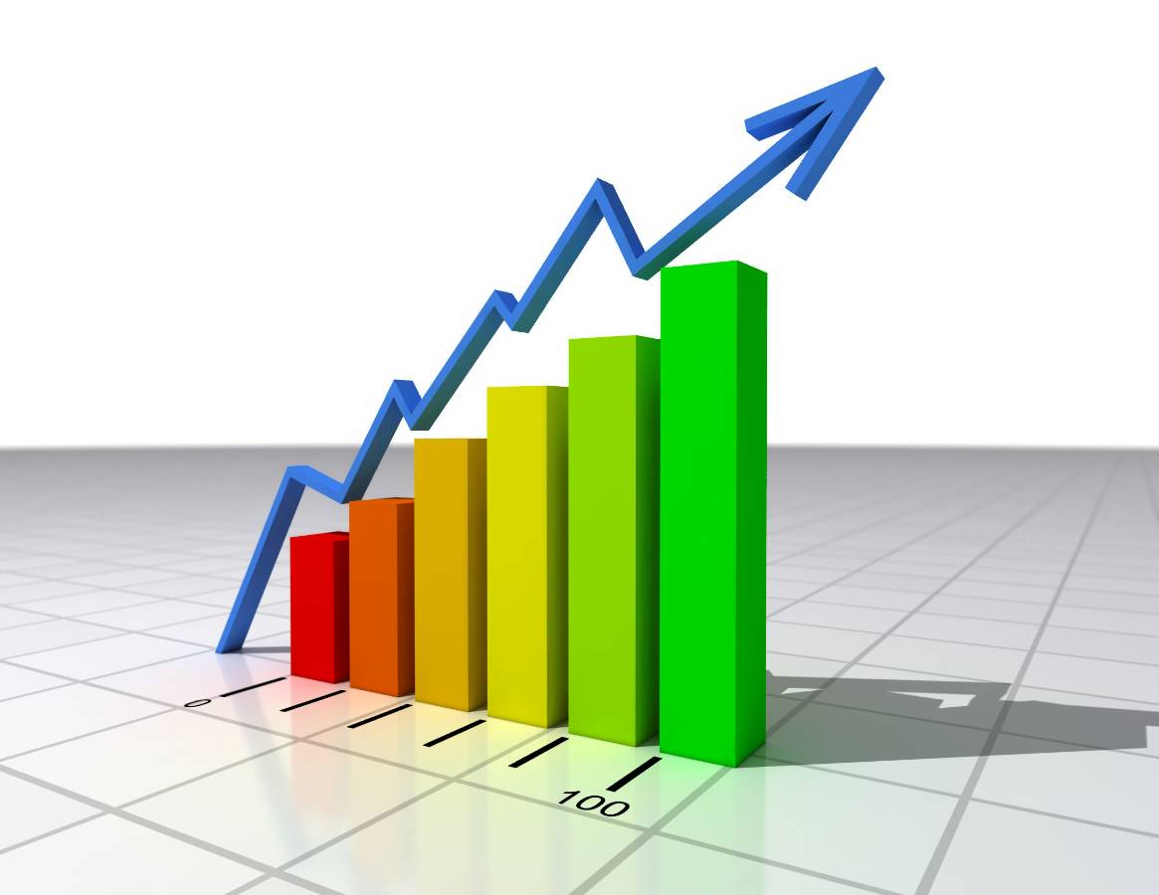
Auspicious
Favorable, promising, pointing to a good result.

Slide 4
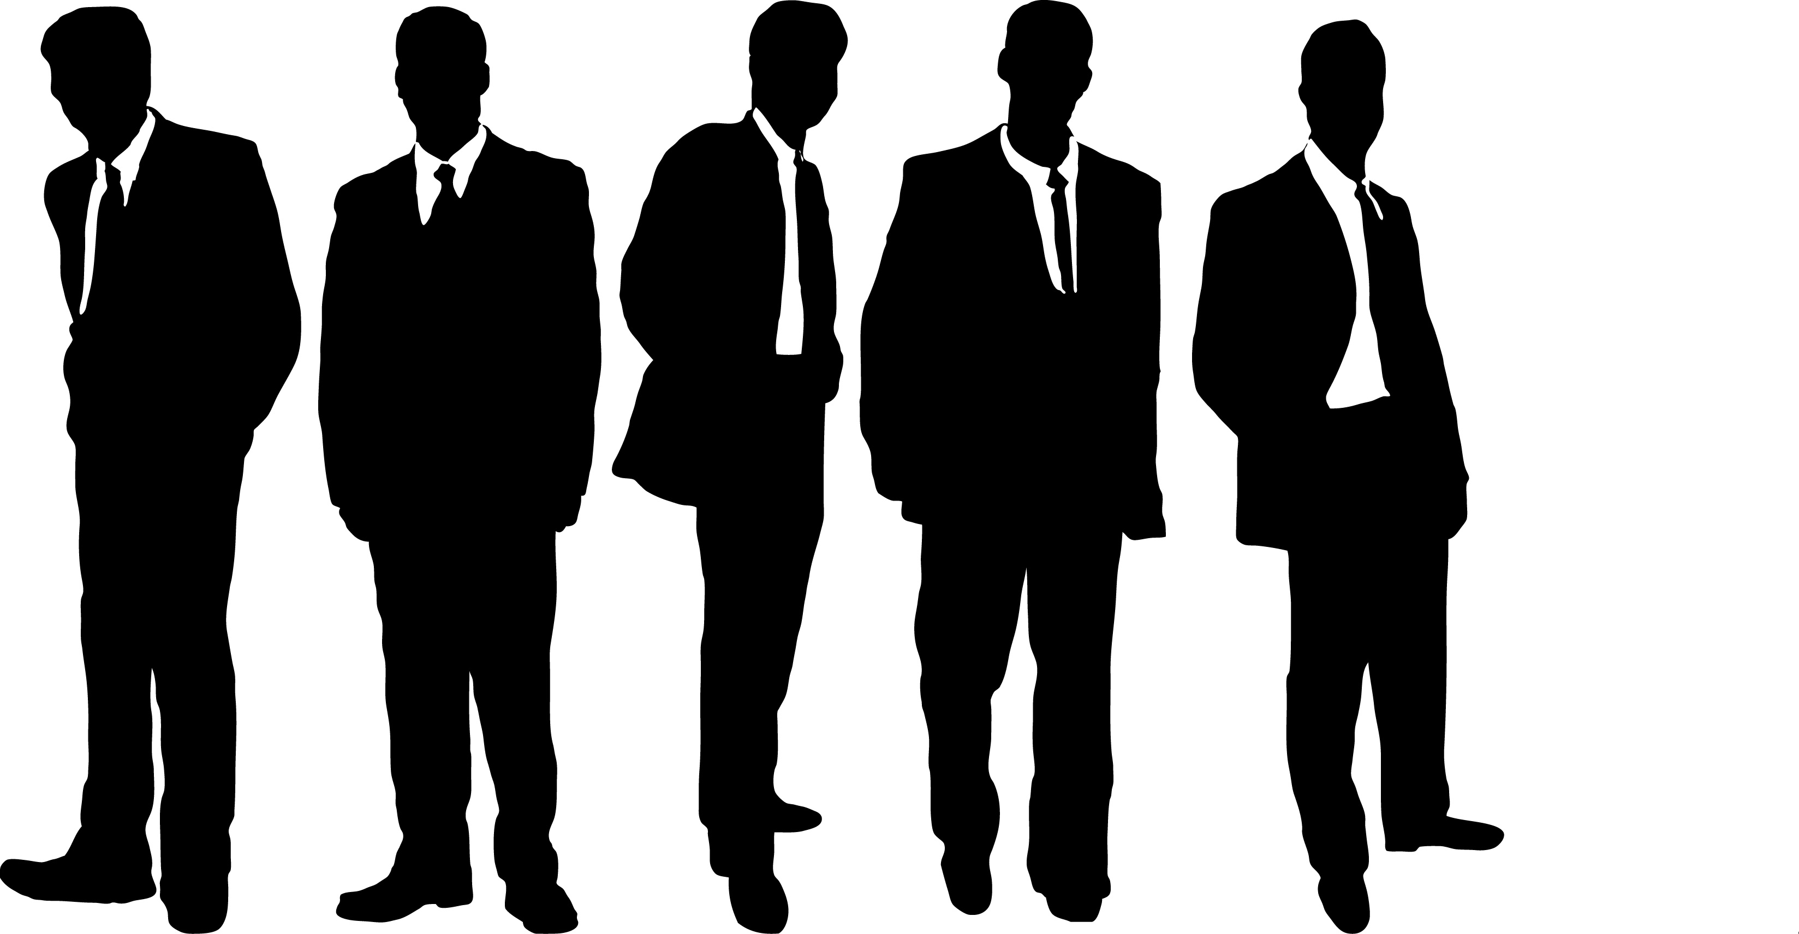
Brethren
A group of relatives or male associates within the same organization.

Slide 5
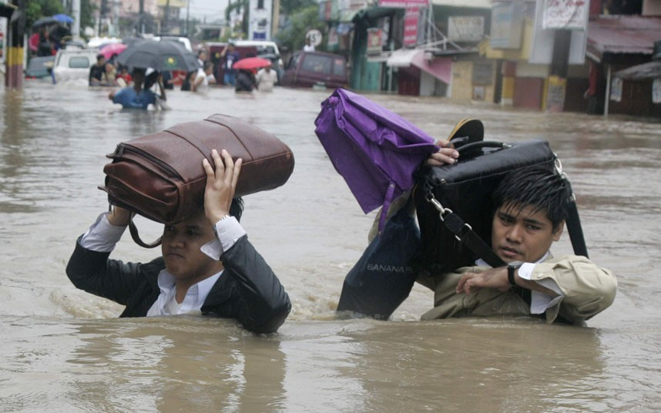
Impotent
Powerless; helpless; unable to perform.

Slide 6
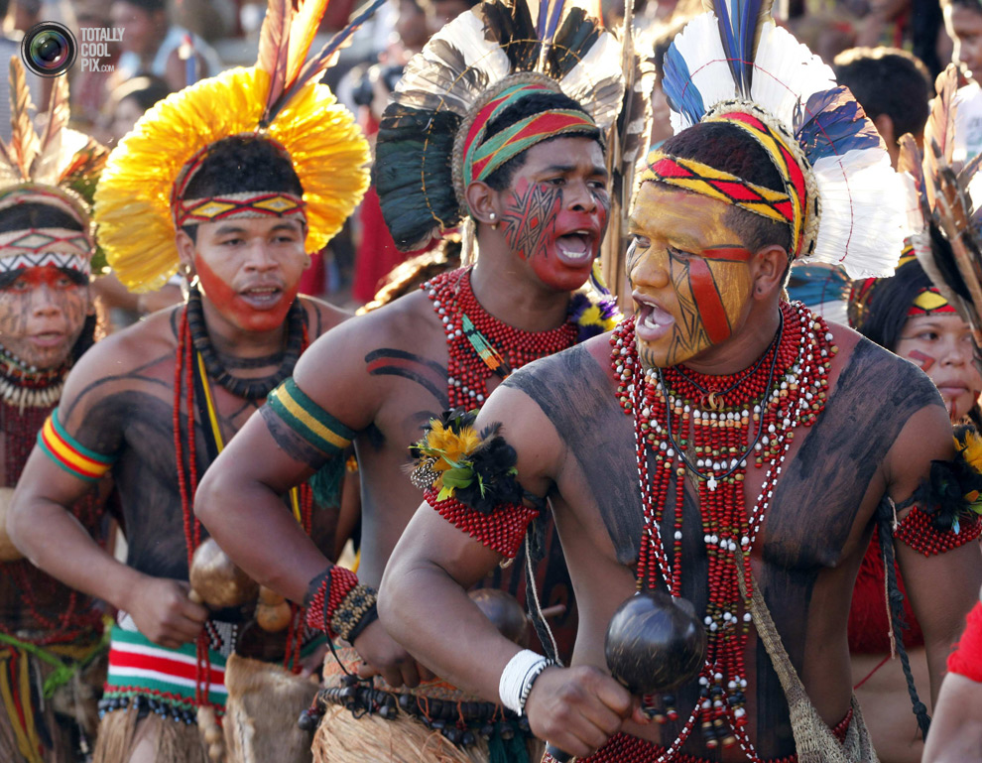
Indigenous
Naturally living or growing in a certain area.

Slide 7
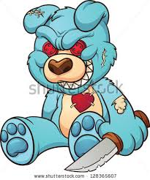
Malevolent
Extremely mean or malicious; evil.

Slide 8
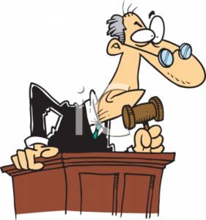
Persecution
Unjust treatment (especially on the basis of race or religion).

Slide 9
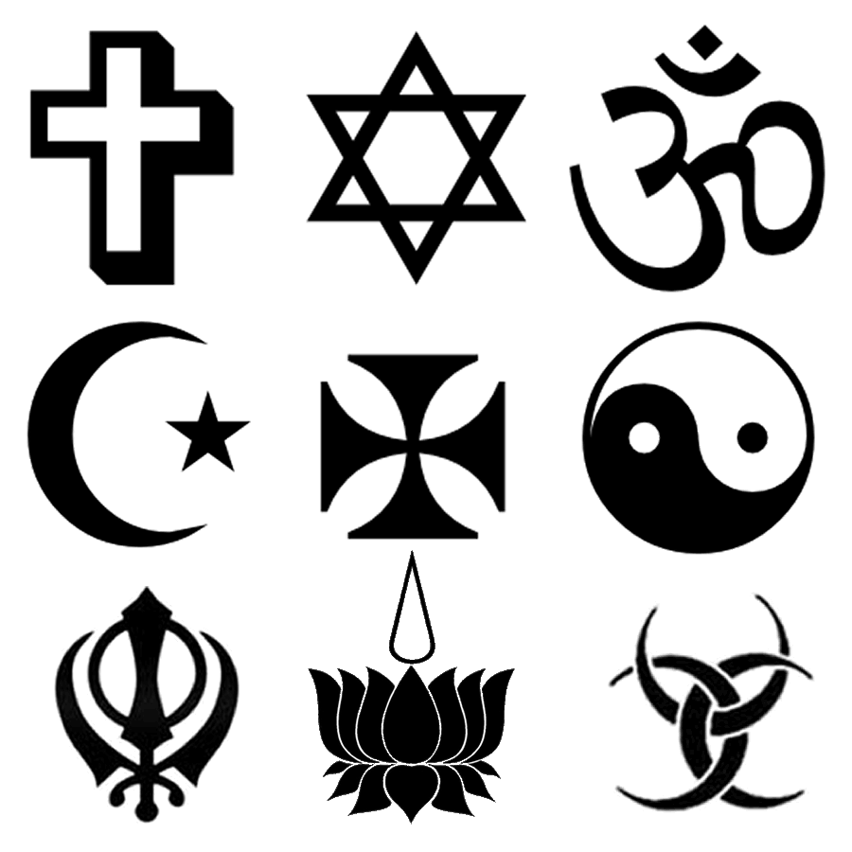
Piety
Religious devotion and reverence to God.

Slide 10
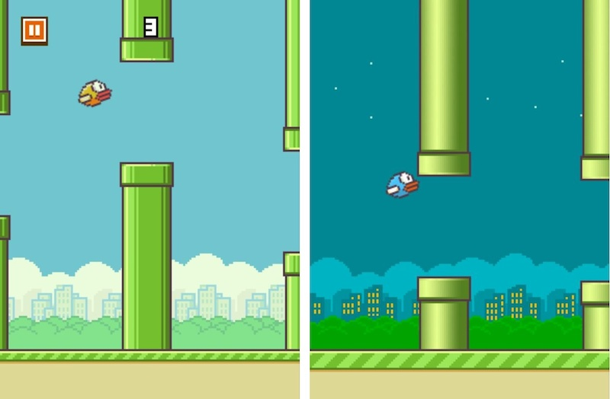
Predilection
A strong liking.

Slide 11
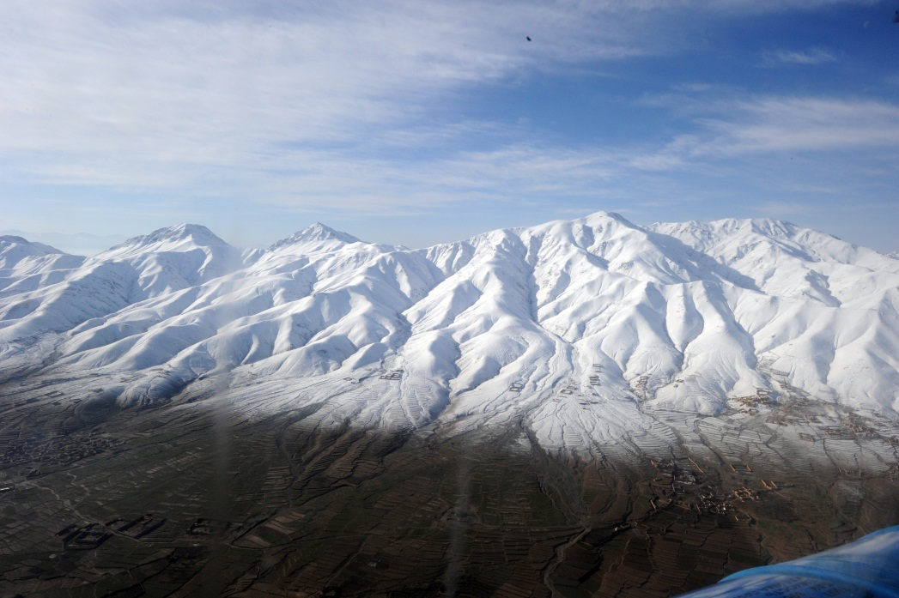
Unsullied
Spotlessly clean and fresh. “The unsullied snow of mountains.”

