Slide 1
Kaffir Boy
Chapters 13 & 14
Summaries

Slide 2
Chapter 13

Slide 3
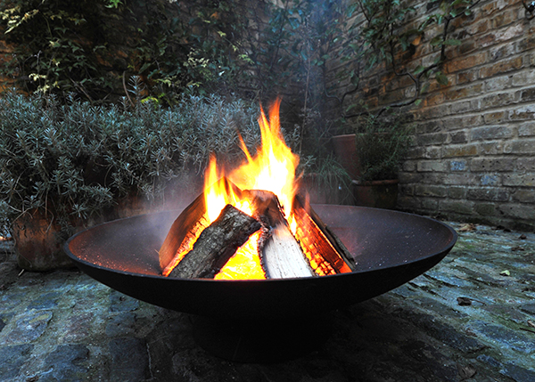
Because the winter is so cold and they have no electricity or indoor heat, Mama would keep a small coal-burning stove on in the house all day (called a brazier). She would take it outside at night.

Slide 4
One night, Mark woke up and felt like some invisible force was choking him. He couldn’t breathe. He starts kicking, and kicks Florah, who falls off the bed, hits the brazier, and starts screaming that she’s on fire.
Mama runs out of the bedroom and throws urine on Florah (this was a typical way to treat burns because they couldn’t afford medicine).

Slide 5
Mark explains that he’s choking, and Mama rushes him outside. She yells at Papa to help her get the children outside.
It turns out, she had forgotten to remove the brazier that night, and they were all dying of poison gas fumes.

Slide 6
Chapter 14

Slide 7
Maria gets sick and Mama decides to take her to the clinic, even though they have no money.
Left alone, Mark joins a group of boys taunting the “shit-men,” the men who gather the feces and urine buckets in the outhouses.
That day, the “shit-men” are in no mood to be taunted, and they run after the boys. Mark is caught, and they take him to his house.

Slide 8
With no adults around, they can do what they like, and they force Mark to stand in a bucket of feces and urine. They threaten to make him eat some, but don’t carry out the threat.
After they leave, Mark tries to clean himself as best he can, but there’s not enough water.

Slide 9
Mama returns home and scolds him for making fun of the “shit men.” They do unpleasant but necessary work, she tells him. And besides, they have no choice.
Mark decides never to make fun of anybody again.

