Slide 1
To Kill a Mockingbird
Vocabulary Terms for Chapters 9 – 11

Slide 2
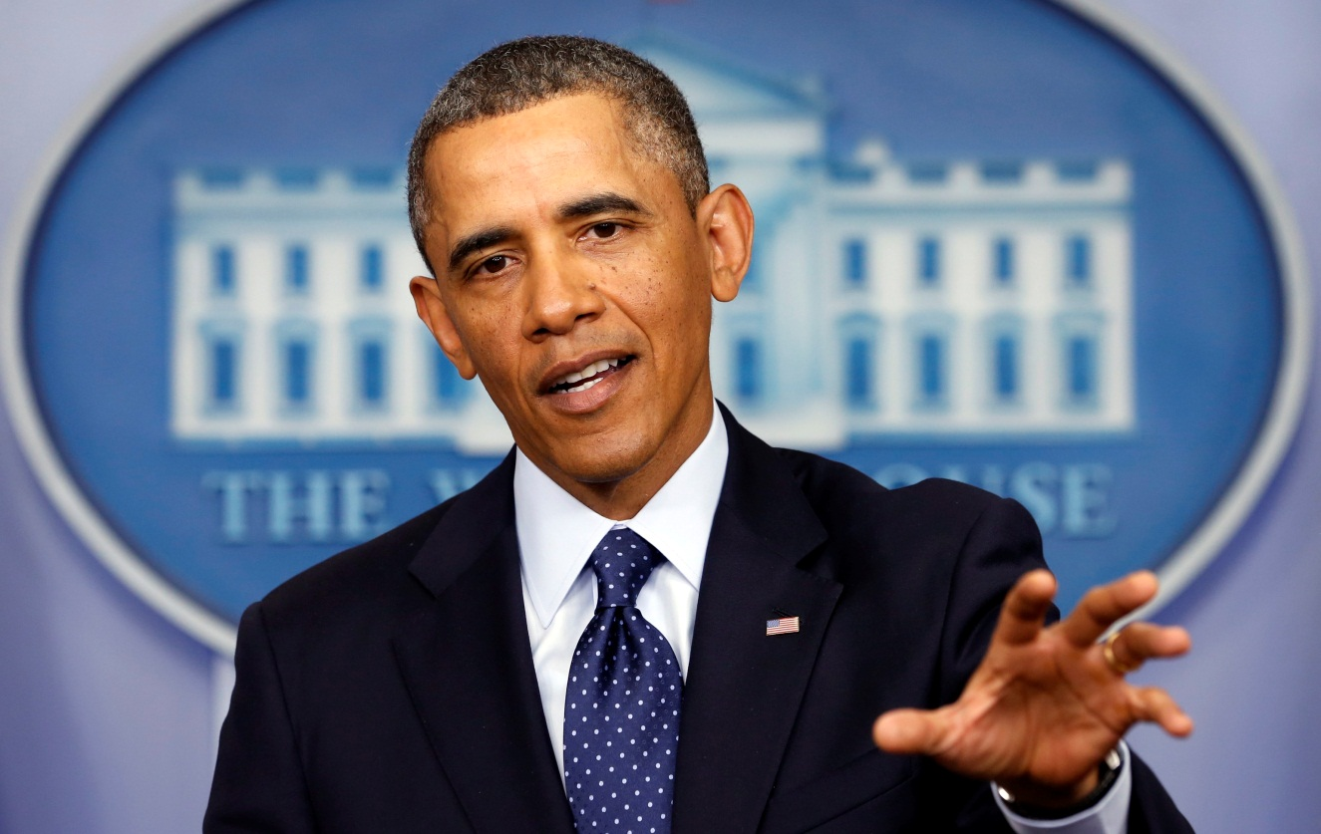
Articulate
The ability to speak clearly.

Slide 3
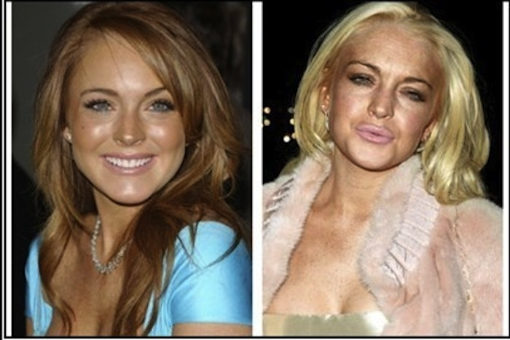
Degeneration
Decline or deterioration.

Slide 4
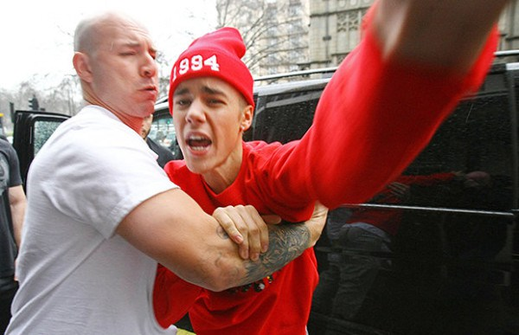
Erratically
Behaving in a way that is unpredictable or unsteady.

Slide 5
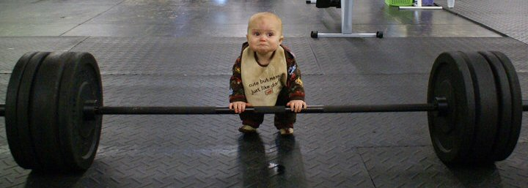
Feeble
Not having physical strength.

Slide 6
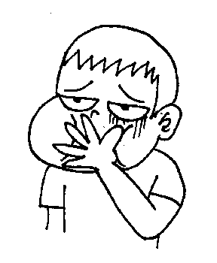
Nauseating
Sickening, stomach-churning.

Slide 7
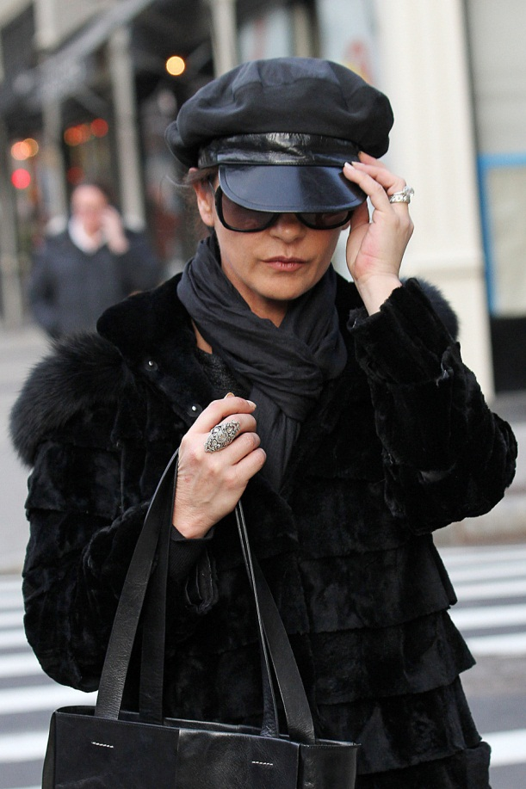
Obscurely
Hidden, secret, or remote.

Slide 8
Passe
No longer fashionable; out of date.

Slide 9
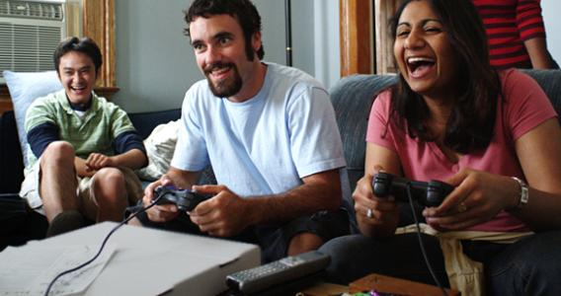
Simultaneous
Happening at the same time.

Slide 10
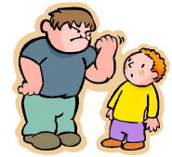
Tormenting
To make someone suffer.

Slide 11
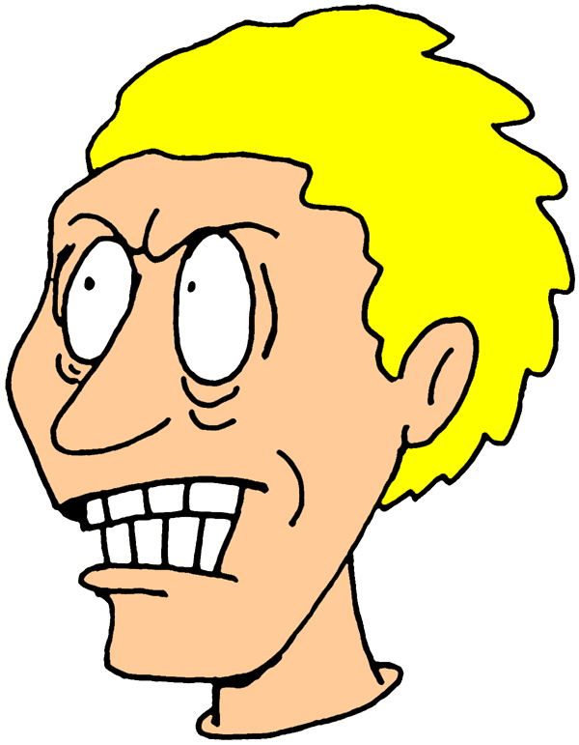
Vehemently
Intensely; emotionally.

