Slide 1
Of Mice & Men Vocabulary Visuals
ELA 10
SLHS

Slide 2
Ch 1 Vocab Ch 1 Vocab OM&M OM&M
Bindle
Lumbered
Yammered
Recumbent
morosely
Bindle
Lumbered
Yammered
Recumbent
morosely

Slide 3
recumbent
Reclining or inactive

Slide 4
morosely
grumpliy

Slide 5
bindle
A bundle of possessions carried by a stick

Slide 6
lumbered
To move clumsily

Slide 7
yammered
To whine or complain

Slide 8
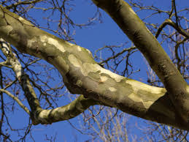
mottled
Marked with spots or smears of color

Slide 9
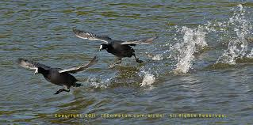
skittering
Move lightly and quickly

Slide 10
unslung
Remove something where it was hanging

Slide 11
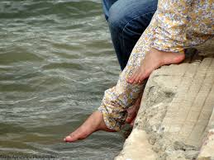
dabbled
Moved hands or feet around gently in water

Slide 12
droned
Continuous low humming noise

Slide 13
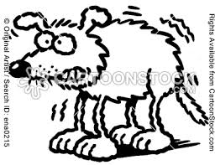
quivered
Shake with slight but fast motion

Slide 14
Chapter 2 Vocab Chapter 2 Vocab

Slide 15
Swamper
A person who helps out by cleaning

Slide 16
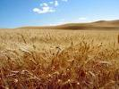
barley
grain used for livestock feed, malt production, and cereal.

Slide 17
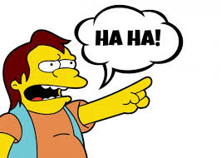
scoff
Mock or make fun of someone

Slide 18
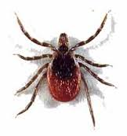
scourges
Person or thing that causes great trouble or suffering

Slide 19
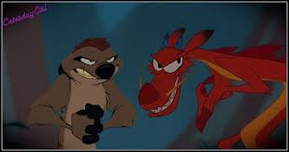
calculating
Schemeing

Slide 20
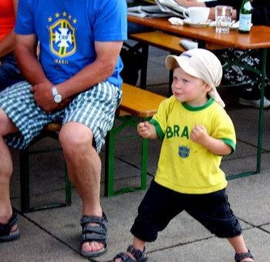
pugnacious
Quick to fight or argue

Slide 21
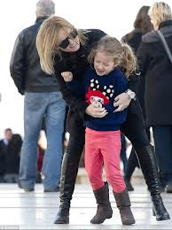
squirmed
Twist body because nervous or uncomfortable

Slide 22
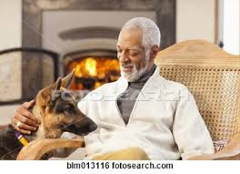
gingerly
Carful manner

Slide 23
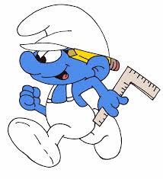
handy
useful

Slide 24
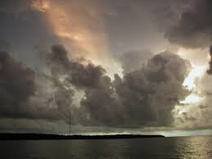
ominously
Feeling something bad is about to happen

Slide 25
slough
Soft muddy ground

Slide 26
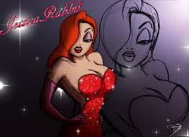
tart
A woman who dresses provocatively and sleeps with many men

Slide 27
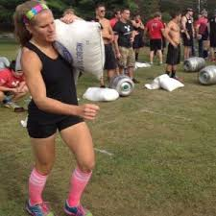
buck
To move a heavy load

Slide 28
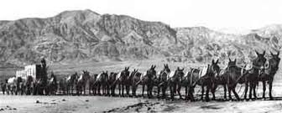
Jerkline Skinner
Main driver of a mule team that jerks the reins rather than call out at the mules

Slide 29
Chapter 3 Vocab Chapter 3 Vocab

Slide 30
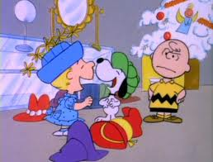
derision
insults

Slide 31
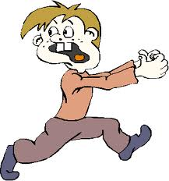
scrammed
Leave a place quickly

Slide 32
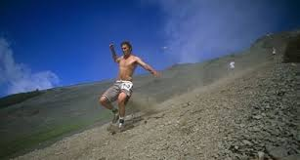
scuttled
Run with short, quick steps

Slide 33
Whing Ding
Expression meaning approval of something…”cool”

Slide 34
raptly
attentively

Slide 35
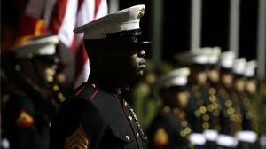
reverently
respectfully

Slide 36
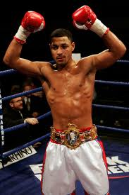
welter
Boxer between 104-147 pounds

Slide 37
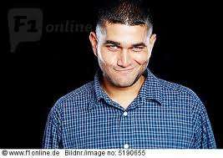
wryly
Humorously

Slide 38
Chapter 4 Vocab Chapter 4 Vocab

Slide 39
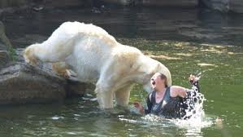
mauled
attacked

Slide 40
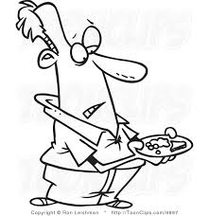
meager
insufficient

Slide 41
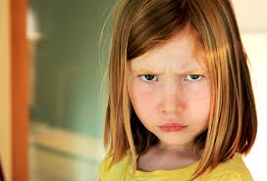
scowled
glared

Slide 42
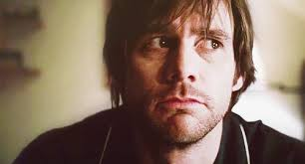
averted
avoided

Slide 43
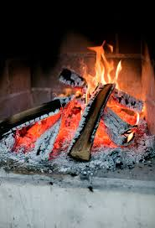
subsided
diminished

Slide 44
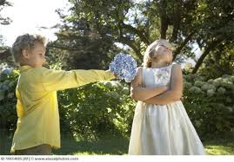
aloof
Unfriendly or standoffish

Slide 45
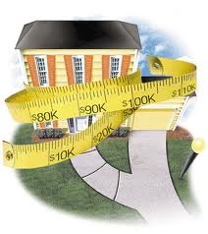
appraised
Evaluated for a value of what something is worth

Slide 46
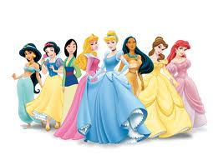
disarming
Charming and enchanting

Slide 47
Chapter 5 & 6

Slide 48
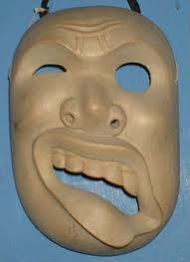
contorted
Twisted out of shape

Slide 49
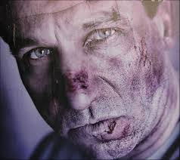
battered
abused

Slide 50
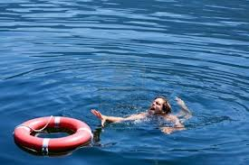
writhed
struggled

Slide 51
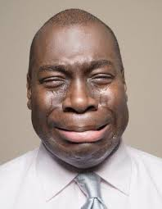
sniveled
cried

