Slide 1
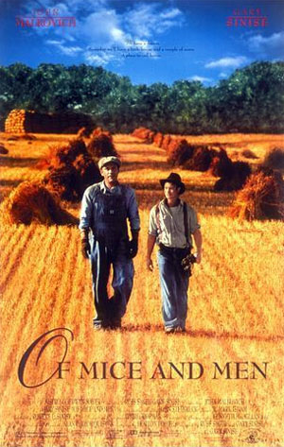
Of Mice and Men Chapter 1
John Steinbeck
Realistic Fiction

Slide 2
Literary Elements:
Point of View The vantage point from which the story is told
Foreshadowing Use of clues to hint at events that will occur later
Style The particular way in which a writer uses a language
Allusion Reference to a statement, a person, a place, or event from literature, poetry, history, politics, mythology, etc.

Slide 3
Vocabulary:
Word | Page # | Definitions
1. Juncture | 1 | Point where two things meet
2. Recumbent | 1 | Lying down; leaning, resting
3. Morosely | 4/12 | In a gloomy way, sad, surly, sullen
4. Brusquely | 8 | Abruptly, bluntly
5. Imperiously | 8/9 | In a commanding, authoritative way
6. Mottled | 1 | Spotted or blotched
7. Lumbered | 7/8 | Moved ponderously, as though weighed down
8. Skittering | 1 | Light, rapid skipping sound
9. Scowled | 4 | Looked angry or threatening
10. Periscope | 7 | Instrument for seeing something higher up

Slide 4
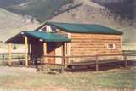
Setting:
The ranch & in the bunkhouse

Slide 5
Characters:
George | main protagonist
Lennie | Other major protagonist
Candy | Old ranch worker, lost one hand
Curley | Ranch boss’s son
Curley’s Wife | No name; flirts with ranch workers
Slim | Master skinner (mule driver); accepts people as they are
Carison | Ranch worker
Crooks | Black stable hand; proud, lives by himself

Slide 6
Exposition:
Exposition- Action occurring early within a story to explain background information needed in order to understand the whole story.
George and Lennie are two itinerant workers who are friends. They are on their way to a job at a ranch in Soledad, CA. They have just quickly escaped from Weeds (another town), where Lennie was accused of trying to attack a young woman. They dream of a better life made possible by their earnings at the ranch.

Slide 7
Themes:
Loneliness | All major characters suffer from it; part of life for these workers; this is why George and Lennie stay together.
Hopes and Dreams | Several characters are searching for a way to overcome isolation and low social status
Dignity and Pride | Their dream gives George, Lennie, Candy, and Crooks a sense of dignity and pride (to succeed where others like them have failed)
American Dream | George and Lennie dream of buying a place of their own and living off the land; others want to join them; Curley’s wife dreams of being a big Hollywood movie star
Sense of Morality | This makes George regret the pranks he plays on Lennie. He protects him from others. Lennie’s moral sense makes him miserable when he’s done “a bad thing.”

Slide 8
Style:
The novel is written in 3rd person, omniscient (all seeing) point of view.
Chapter 1 is written very poetically at the beginning. The language used is in a lyrical style. It contrasts very much with the down-to-earth, rough language found in the rest of the novel.

Slide 9
Foreshadowing:
The author tells us of the past incident in Weeds. He does this to prepare the reader for the larger tragedy to come. Keep it in mind in order to understand the mood of the novel.

Slide 10
Characterization: Lennie
Lennie lacks sophistication. He doesn’t know enough to let go when another person pulls away and doesn’t know that it is inappropriate to touch certain things. He becomes terrified when George fusses at him and threatens to leave.

Slide 11
Characterization: George
George’s attitude and behavior changes very much after his outburst at Lennie. George needs Lennie as much as Lennie needs George. George’s verbal roughness stems from frustration and gruff affection.

