Slide 1
Kaffir Boy
Vocabulary
Part 1

Slide 2
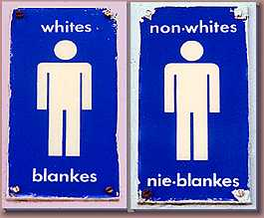
apartheid
System of legalized racism in South Africa

Slide 3
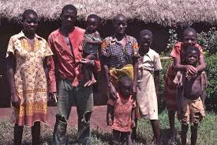
Bantu
Native South African person/tribe

Slide 4
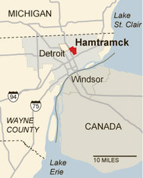
Enclave
Region surrounded by foreign territory

Slide 5
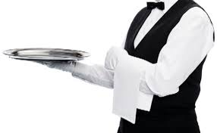
Indentured
Written agreement for work; slightly higher status than slavery

Slide 6
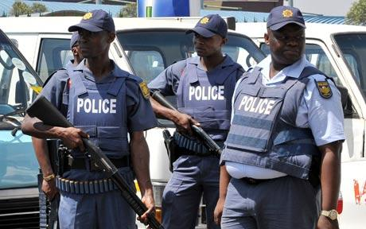
Peri-Urban
South African police

Slide 7
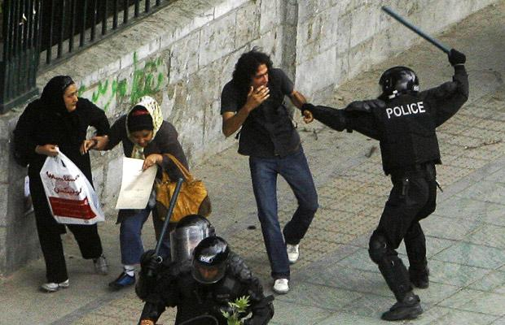
Truncheon
Police baton

Slide 8
Indelible
Unforgettable

Slide 9
Affluence
Wealth or richness

Slide 10
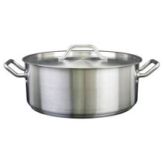
Brazier
Metal containers for hot food

Slide 11
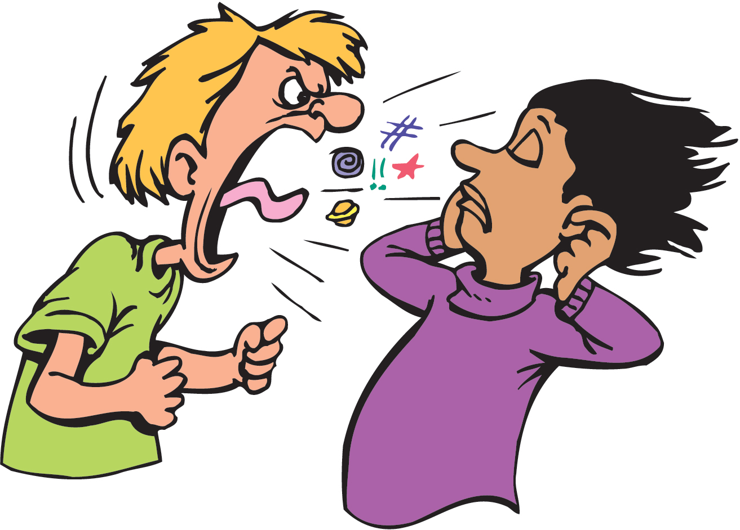
Insolence
Disrespect

Slide 12
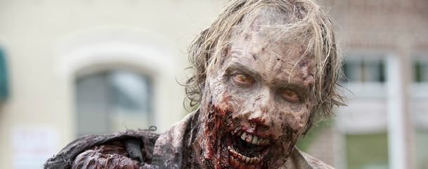
Ominous
Threatening

Slide 13
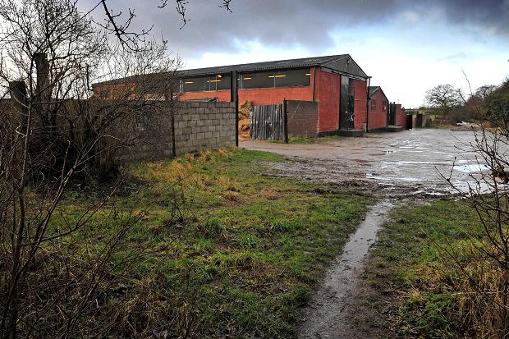
Abattoir
Slaughterhouse

Slide 14
Copiously
Abundantly (a lot of)

Slide 15
Solace
Relief or a source of comfort

Slide 16
Chivalrous
Considerate or courteous; knightly

Slide 17
Quagmire
Mystery or puzzle; enigma

