Slide 1
A Raisin in the Sun
Chapter 1

Slide 2
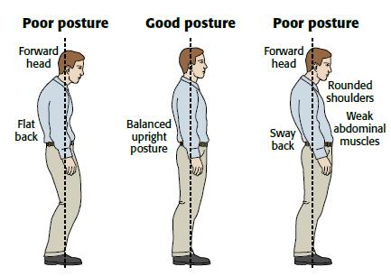
Carriage
The manner in which someone holds his body; posture

Slide 3
Clinically
Objectively, coldly

Slide 4
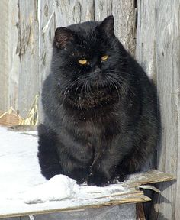
Dusky
Dark colored

Slide 5
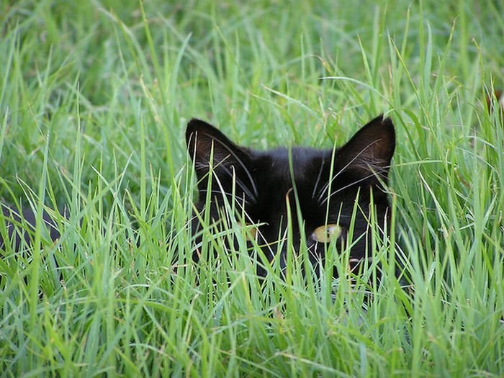
Furtively
Sneakily

Slide 6
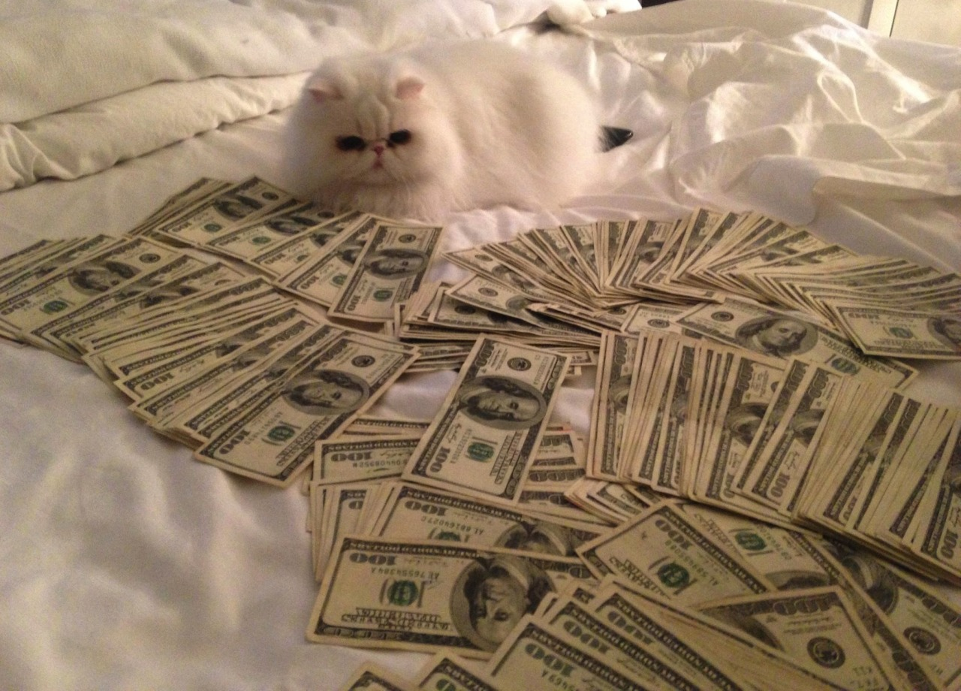
Graft
Gaining profit through buying influence

Slide 7
Graphically
Vividly; powerfully

Slide 8
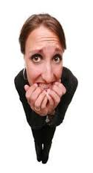
Neurotic
A person suffering from an emotional disorder

Slide 9
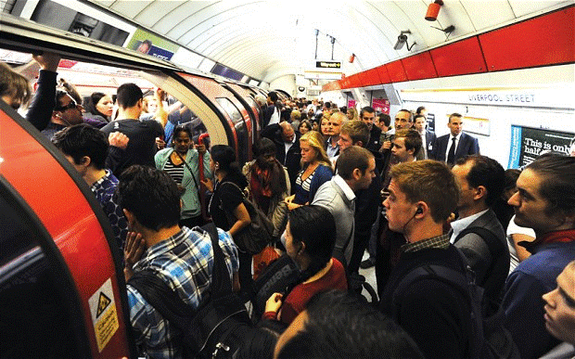
Squinch
To squeeze together

