Slide 1
Witches

Slide 2
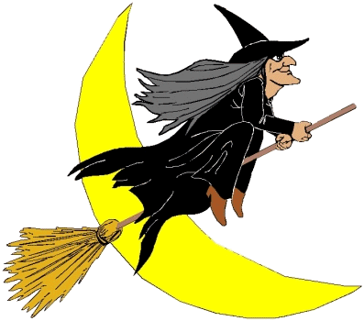
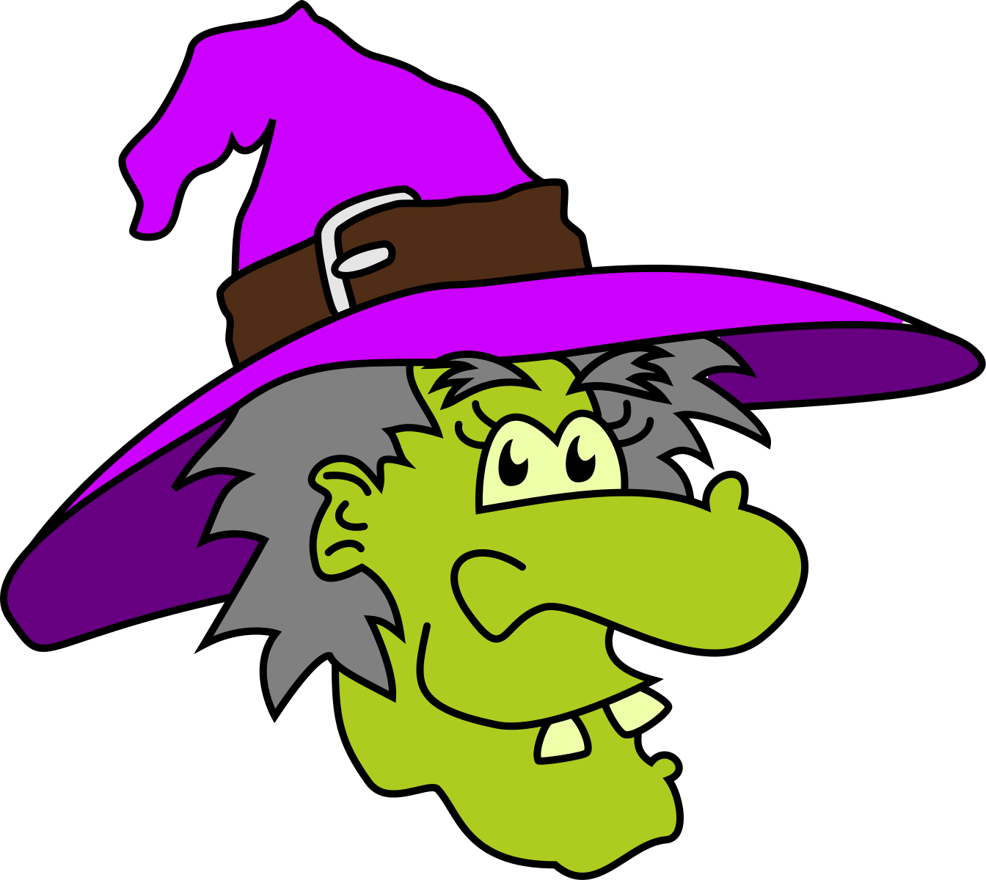
What are “witches”?
A witch is a person who practices witchcraft.
A Warlock is not a male witch. It means “traitor” or “devil.”
Stereotypical witches are commonly portrayed as wicked old women who have wrinkly skin, pimples, and pointy hats. They wear clothes that are black or purple. They also have warts on their noses, and sometimes have long claw-like fingernails.

Slide 3
Witches Around the World
The belief in witchcraft can be found in many cultures all over the world.
People have claimed to see witches all around the world.
As a consequence, people often made witches feel unwanted.

Slide 4
Witches in Religion
In the Bible, the punishment for witchcraft is death.
In Europe in the early times, witch hunts and witch trials took place. Many Christians were scared of witches and witchcraft during that time.
As a result, about 60 people were tried for witchcraft and executed.
Most were hanged.
Some were burned at the stake.
Women were burned at the stake for simply sweeping their porches on Sundays or putting herbs in a soup.
Among those punished were people who did not live peacefully with their rulers, like Joan of Arc.

Slide 5
Common Ideas about Witches
During the early Modern Age, the (mostly Catholic) Church developed a whole set of teachings and beliefs about withes. These beliefs were centered around the following:
Witches were able to fly around on brooms, sticks, animals, and/or demons.
Witches meet with other witches, and with the devil.
Witches have a pact with the devil.
Witches can use magic spells to do bad things to others.

Slide 6
How people were identified as witches
The “mark of the devil” (a mole or birthmark).
A pact with the devil.
Being denounced by another witch.
A relationship with a known witch.
To harm someone with sorcery.
To have one or more witches in the family.
To be afraid during interrogations (most included torture).
To not cry when tortured.
To have red hair.
The “swim” test: the suspected witch would have a rope tied around the waist and rocks attached to their feet. The suspected witch was then thrown into the water. If they drowned (which is more than likely) they were wrongly accused. If they floated, they were a witch and a trial would be held.

Slide 7
The Mark of the Devil
People believed that witches had a pact with the devil. The diabolical mark (or the mark of the devil) was a token left on the skin of the witch.
Most of the time, this was believed to be a mole or a birthmark. It was said that since this was a sure sign of the devil, touching or picking it would not hurt the person. People also thought this mark could not bleed.
This soon developed into a safe test for witchcraft. Most often, special techniques were used during the test, so that the pricked spot would not bleed or hurt.

